Slide 1

Course Project 7: GAN
Hands on Artificial Intelligence and Robotics
Lingxiao Wang, Ph.D.
Assistant Professor of Electrical Engineering
Louisiana Tech University

Slide 2
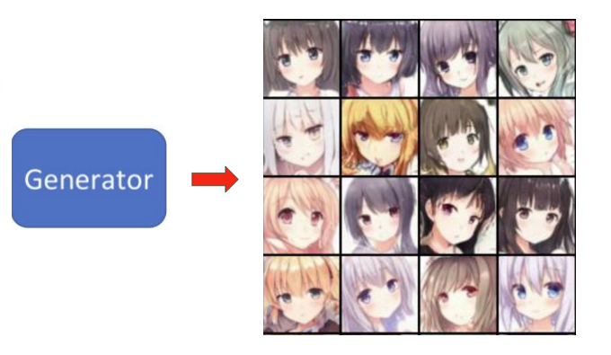
Task Introduction
Anime Face Generation: train a GAN to generate anime faces.
Dataset:
Crypko (https://crypko.ai/en/) is a collection of anime face images
Total 71314 images in the dataset

Slide 3
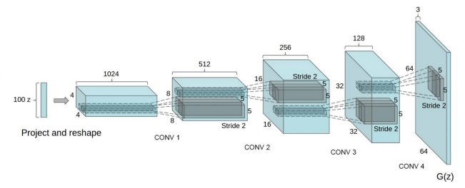
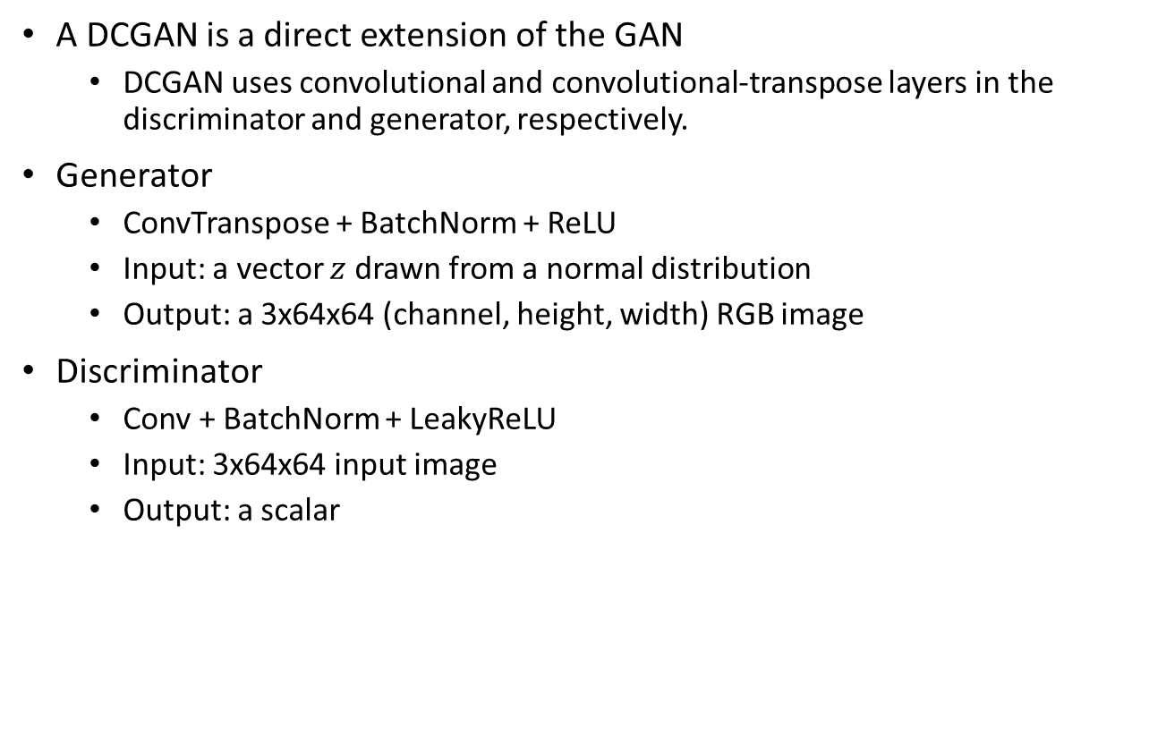
Deep Convolutional GAN (DCGAN)
https://arxiv.org/abs/1511.06434
A DCGAN is a direct extension of the GAN
DCGAN uses convolutional and convolutional-transpose layers in the discriminator and generator, respectively.
Generator
ConvTranspose + BatchNorm + ReLU
Input: a vector $z$ drawn from a normal distribution
Output: a 3x64x64 (channel, height, width) RGB image
Discriminator
Conv + BatchNorm + LeakyReLU
Input: 3x64x64 input image
Output: a scalar

Slide 4
Sample Code
Colab link:
https://colab.research.google.com/drive/18lAJjrloJJx15mRctHjgXV-dChoMZaOh?usp=sharing

